Slide 1
PG&E Proposals for Refinements to the Resource Adequacy (RA) Program (effective 2016)
RA Workshop
February 9, 2015

Slide 2
Modifications to QC and EFC Methodologies

Slide 3
PG&E Proposal to Modify the Effective Flexible Capacity (EFC) Calculation for Storage Resources with Non-Zero Transition Periods
Problem Statement
Under the current flexible RA counting rules, storage resources with a non-zero transition time between charge and discharge can only count their discharge capacity towards their EFC value, despite the ability of these resources to provide flexibility by charging.
Proposed Solution
The Commission should modify the flexible RA counting rules for storage resources to include the full range of charge and discharge that a storage facility can achieve and sustain over a three-hour period, so long as the resource’s transition time between the two states is less than 45 minutes.
Justification for Proposal
Equal treatment for all storage resources
Reduces costs to customers
Fair valuation of all existing and potential storage resources (storage RFOs)
Helps prevent over-procurement

Slide 4
The Flexible Contribution of a Hypothetical 1,000 MW Storage Resource with a 45-Minute Transition Time – Typical Winter Day in 2020
Total Reduction in upward ramp: 2,000 MW
Key Takeaway: A storage resource with a non-zero transition period reduces ramping needs in the same manner as a storage resource with a zero transition period.

Slide 5
PG&E Proposal to Modify the Qualifying Capacity (QC) Calculation for Resources That Can Be Scheduled in Day-Ahead and Pre-Day-Ahead Timeframes
Problem Statement
There is a disincentive to re-structure contracts to provide additional operational flexibility under the current RA rules because doing so results in lower QC values
Proposed Solution
The Commission should modify the system and local RA counting rules for resources that are capable of operating in accordance with day-ahead and pre-day-ahead scheduling instruction, but are not fully capable of responding to real-time dispatch instructions, so that the QC values for such resources are equal to Pmax, rather than based on historical output.
Justification for Proposal
Recognize the QC value of a resource that can be scheduled to its Pmax when the CAISO finds it beneficial to do so
Help address potential over-generation conditions by creating an incentive to operate flexibly
Provide more operational flexibility to the CAISO
Helps prevent over-procurement
Reduces costs to customers

Slide 6
Decrease in QC for a QF Unit Resulting from Conversion to Pre-Scheduled Operation
NQC values based upon 3-year historical meter data decrease as the resources run only when economic conditions support operation.
Contracts renegotiated with additional operational flexibility
Key Takeaway: Resources able to be pre-scheduled or economically dispatched on a day-ahead basis (but unable to be fully dispatched in real-time) are penalized under the QC calculation for providing additional operational flexibility.

Slide 7
PG&E Proposal on QC Manual Update
Problem Statement
The Commission’s QC methodology manual has not been updated since its initial adoption in 2010, despite a number of refinements to the QC methodologies being adopted by the Commission since that time.
Proposed Solution
The Commission should complete a comprehensive update of the QC methodology manual following the anticipated June 2015 RA decision.
Justification for Proposal
Provides a single source of information for the current QC methodologies.
Provides an opportunity to provide more detail and clarity on the methodology used by Energy Division to calculate QC values.

Slide 8
Flexible Capacity Requirements Allocation

Slide 9
PG&E Proposal to Modify the CPUC’s Flexible RA Requirements Allocation Methodology
Problem Statement
The current CPUC methodology used to allocate flexible RA requirements does not reflect cost causation because it is based on load ratio share rather than the load-serving entity’s (LSE) contribution to the largest 3-hour ramps.
Proposed Solution
The Commission should modify the methodology for allocating flexible RA requirements to its LSEs so that the flexible RA requirements are allocated in proportion to the LSEs’ contributions to the CAISO’s monthly net-load ramps used to determine the overall flexible RA requirement.
Justification for Proposal
Better reflects cost causation
Aligns the Commission’s and the CAISO’s allocation approaches
Sends better market signals to developers and LSEs

Slide 10
Appendix

Slide 11
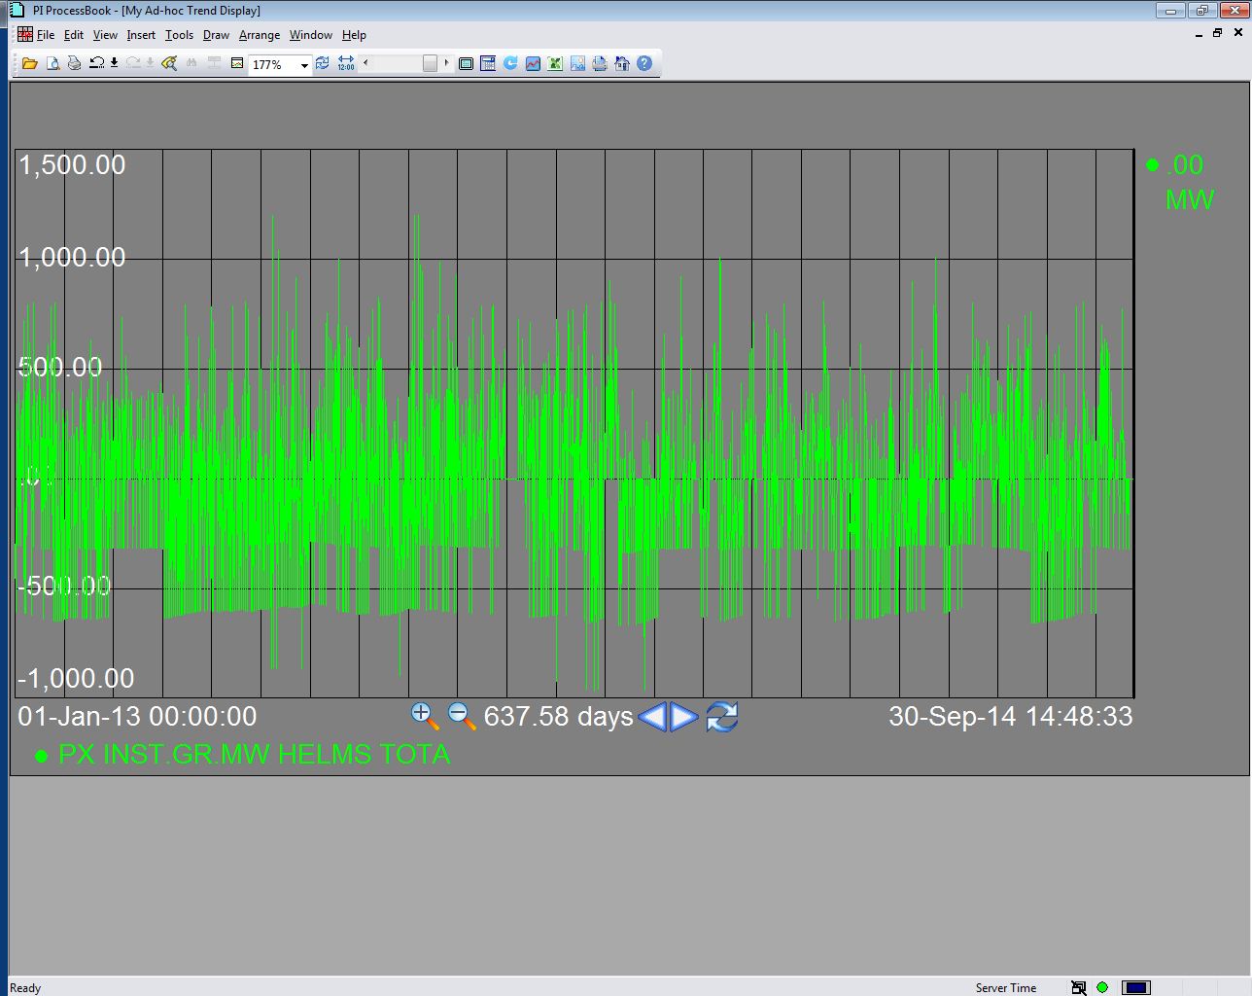
Charge and Discharge Level at Helms Pumped Storage Plant: 2013 Through Q3 2014
Key Takeaway: Helms operates flexibly in both directions (charge and discharge) on a nearly daily basis.

Slide 12
The Flexible Contribution of a Hypothetical 1,000 MW Storage Resource with a 45-Minute Transition Time – Typical Summer Day in 2020
Reduces ramp by 1,000 MW when discharging
Reduces ramp by 1,000 MW when charging
Key Takeaway: A storage resource with a non-zero transition period reduces ramping needs in the same manner as a storage resource with a zero transition period.

