Slide 1
Refinements to CAM-Related Reliability Cost and Capacity Allocation Processes
Jeremy Waen
Regulatory Analyst| Marin Clean Energy
February 2015

Slide 2
Presentation Overview
The Cost Allocation Mechanism (CAM) needs to be reformed, entirely
Until it is reformed, the allocation process by which CAM-related reliability cost and capacity is passed through to non-utility Load Serving Entities (LSEs) should be improved
Possible interim modifications to the CAM-related allocation process
Additional reform for CAM is still necessary
The Cost Allocation Mechanism (CAM) needs to be reformed, entirely
Until CAM is reformed, the allocation process by which CAM-related reliability cost and capacity is passed through to non-utility Load Serving Entities (LSEs) should be improved
Possible interim modifications to the CAM-related allocation process
Additional reform for CAM is still necessary
Notes:
Items 1 & 4 are admittedly out of scope but are necessary to frame the issues and refinement proposals that are within scope.

Slide 3
1. CAM Needs Reform
What CAM presently means for CCAs:
The IOU can purchase resources for itself and CCAs, and interfering with CCA procurement autonomy
Both the costs of capacity and reliability due to the IOU’s procurement are imposed on CCA customers, along with an share of the capacity due to the procurement
These allocations shift unpredictably over time, create market inefficiencies and strand capacity costs for CCA customers

Slide 4
1. CAM Needs Reform
Why is this a problem?
By law, CCAs have procurement autonomy
CCAs cannot control the cost or resource type due to the unpredictability of CAM
CCAs procure in advance for their customer load, so discrepancies in CAM allocations force the CCA to over-procure capacity and sell excess, usually at a loss
CAM does not account for the increased reliability due to CCA procurement
CAM is growing rapidly

Slide 5
1. CAM Needs Reform
CCA Procurement Autonomy:
P.U. Code Section 366.2(a)(5)
  CCAs “shall be solely responsible for all generation procurement activities” on behalf of its customers, except as “expressly authorized by statute.”
P.U. Code Section 380(b)(4)
  “In establishing resource adequacy requirements, the commission shall… maximize the ability of community choice aggregators to determine the generation resources used to serve their customers.”

Slide 6
1. CAM Needs Reform
CAM Is Growing!
 | CAM as % of MCE Total RA Requirement
January 2013 | 3.7%
January 2014 | 13.3%

Slide 7
2. CAM Allocations Need Reform
Why is this a problem?
By law, CCAs have procurement autonomy
CCAs cannot control the cost or resource type due to the unpredictability of CAM
CCAs procure in advance for their customer load, so discrepancies in CAM allocations force the CCA to over-procure capacity and sell excess, usually at a loss
CAM does not account for the increased reliability due to CCA procurement
CAM is growing rapidly
Why is this a problem?
By law, CCAs have procurement autonomy
CCAs cannot control the cost or resource type due to the unpredictability of CAM
CCAs procure in advance for their customer load, so discrepancies in CAM allocations force the CCA to over-procure capacity and sell excess, usually at a loss
CAM does not account for the increased reliability due to CCA procurement
CAM is growing rapidly
Notes:
Modifying the CAM allocation process has the potential to partially or completely remedy problems 1, 2 & 3

Slide 8
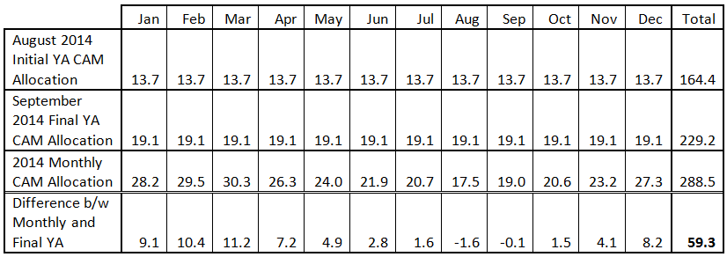
2. CAM Allocations Need Reform
Actual CAM Allocations do not match projections
Source MCE’s Comments on Refinement to 2016-17 RA, filed on January 16, 2105.

Slide 9
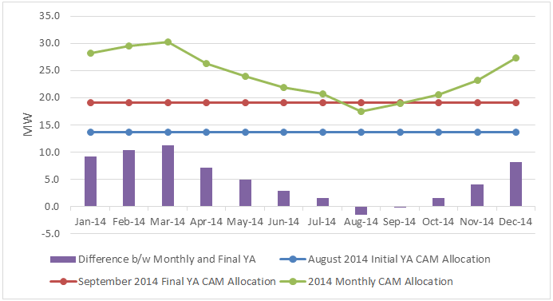
2. CAM Allocations Need Reform
Actual CAM Allocations do not match projections
Source MCE’s Comments on Refinement to 2016-17 RA, filed on January 16, 2105.

Slide 10
3. Possible Interim Modifications to CAM
Solution 1: Unbundling
Steps Required:
Unbundle CAM net capacity costs into reliability and capacity costs
Pass-through reliability costs to all LSEs
Retain capacity costs and values with the procuring utility to meet the its Resource Adequacy requirements

Slide 11
3. Possible Interim Modifications to CAM
Solution 1: Unbundling
Capacity
RA Cost
(based on benchmark TBD)
CAM
Net Capacity Cost =
RA Cost + Reliability Cost
Reliability
Net Capacity Cost
– RA Cost

Slide 12
3. Possible Interim Modifications to CAM
Solution 1: Unbundling
Capacity
RA Cost
(based on benchmark TBD)
Costs Paid by IOU’s bundled customers
Reliability
Net Capacity Cost
– RA Cost
Costs Paid by all ratepayers in IOU’s service territory

Slide 13
3. Possible Interim Modifications to CAM
Solution 1: Unbundling
What this means for CCAs:
Solves CCA procurement autonomy issue
Reduces uncontrollable cost exposure for CCAs from reliability and capacity costs to just reliability costs
Allows CCA to efficiently procure capacity to meet RA obligations

Slide 14
3. Possible Interim Modifications to CAM
Solution 1: Unbundling
What this means for others:
Allows the utility - the entity with resource specific knowledge - to keep the capacity
Allows all LSEs to efficiently procure capacity to meet RA obligations
Simplifies Energy Division’s role by eliminating the CAM capacity pass-through allocation process
Differentiates capacity and reliability needs

Slide 15
3. Possible Interim Modifications to CAM
Solution 1: Unbundling
The Devil in the Details:
What is the appropriate RA Cost by which the Reliability Cost will be determined?
  Should RA Cost be tied to the RA adder used in PCIA methodology?
  Should RA Cost be tied to some other factor or metric for capacity value?
Reliability Cost = Net Capacity Cost - RA Cost
Notes:
It’s a “Goldilocks” issue where we want to define RA Cost properly so that the resultant Reliability Cost, is just right.

Slide 16
3. Possible Interim Modifications to CAM
Other Solutions:
Eliminate the variability of CAM allocations:
  To eliminate discrepancies between September and monthly CAM allocations
Weight monthly CAM allocations:
  To make projected and actual CAM allocations proportionate with seasonal capacity requirements
Other possibilities?

Slide 17
3. Possible Interim Modifications to CAM
Other Solutions:
Source MCE’s Comments on Refinement to 2016-17 RA, filed on January 16, 2105.
Notes:
Discuss modifications that would make the shape of the blue and red lines match the shape of the green line.
Discuss modifications that would bring the blue, red and green lines closer together.

Slide 18
4. Additional Reform Still Needed
Why is this a problem?
By law, CCAs have procurement autonomy
CCAs cannot control the cost or resource type due to the unpredictability of CAM
CCAs procure in advance for their customer load, so discrepancies in CAM allocations force the CCA to over-procure capacity and sell excess, usually at a loss
CAM does not account for the increased reliability due to CCA procurement
CAM is growing rapidly
Why is this a problem?
By law, CCAs have procurement autonomy
CCAs cannot control the cost or resource type due to the unpredictability of CAM
CCAs procure in advance for their customer load, so discrepancies in CAM allocations force the CCA to over-procure capacity and sell excess, usually at a loss
CAM does not account for the increased reliability due to CCA procurement
CAM is growing rapidly
Notes:
Even if problems 1, 2 & 3 are partially or completely remedied by modifications to the allocation process, problems 4 & 5 remain unresolved and should be addressed ASAP (preferably within the ongoing LTPP)

Slide 19
4. Additional Reform Still Needed
What steps remain to reform CAM entirely?
CPUC needs to clearly define what a “local and system area reliability need” is
All LSEs’ reliability procurement should be considered when determining overall reliability need
A mechanism for CCAs to self-procure reliability and opt-out of IOU procured reliability is needed
Notes:
Suggestions for how to address Problems 4 & 5 in a different proceeding (such as LTPP)

Slide 20
Thank You
Questions?

