Slide 1

2013 Efficiency Savings Performance Incentive (ESPI)
Performance Statement Webinar
Energy Division
June 18, 2015

Slide 2

Agenda
Overview
(15 minutes)
2013 ESPI Workbooks
(45 minutes)
2013 ESPI Database
(30 minutes)

Slide 3
Important Dates
ESPI Activity | Date
PY 2013 Draft Evaluation Results Posted | 3/9/2015
PY 2013 Draft Evaluation Results Webinar | 3/25/2015
Public Comments Due | 4/6/2015
Public Comments Incorporated | 5/27/2015
Draft Savings Performance Statement Posted | 6/15/2015
Draft Savings Performance Statement Webinar | 6/18/2015
Written Comments on Performance Statement | 7/13/2015
Final Savings Performance Statement Posted | 8/15/2015*
* Activity must be completed by these dates. Energy Division is currently ahead of this schedule

Slide 4
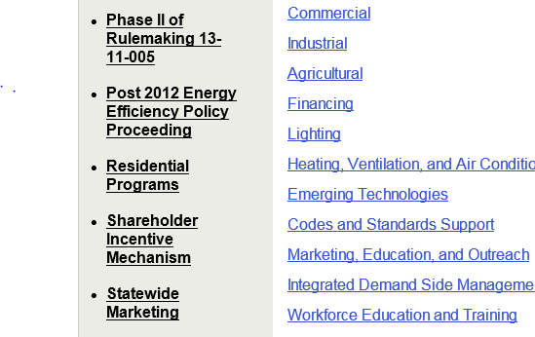
www.cpuc.ca.gov/ee

Slide 5
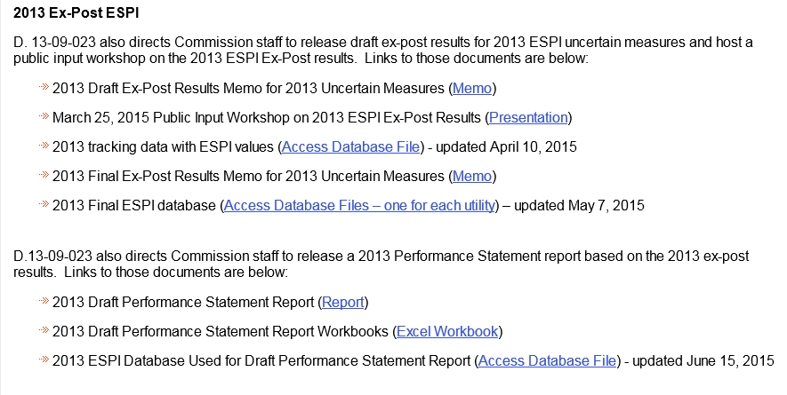
www.cpuc.ca.gov/ee

Slide 6
Overview of Report

Slide 7
Overview of Report
1
Introduction
2
Regulatory Background
3
Earnings
4
Components of Earnings Calculation
5
Creation of Ex-Post Dataset
6
Biggest Drivers of Change in Earnings
7
Appendices

Slide 8
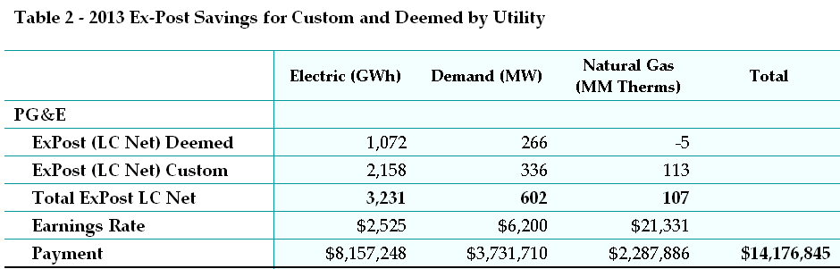
Proposed Earnings

Slide 9
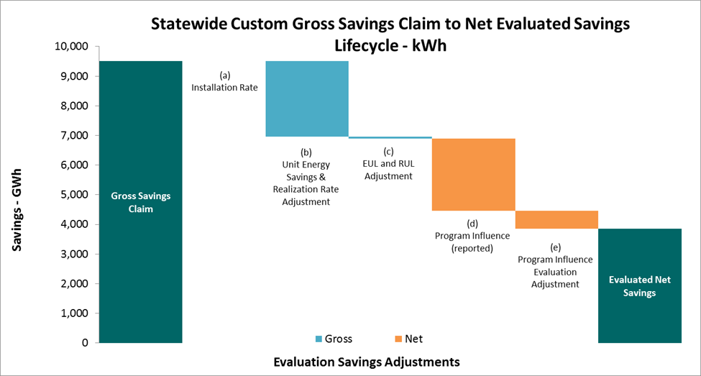
Drivers

Slide 10
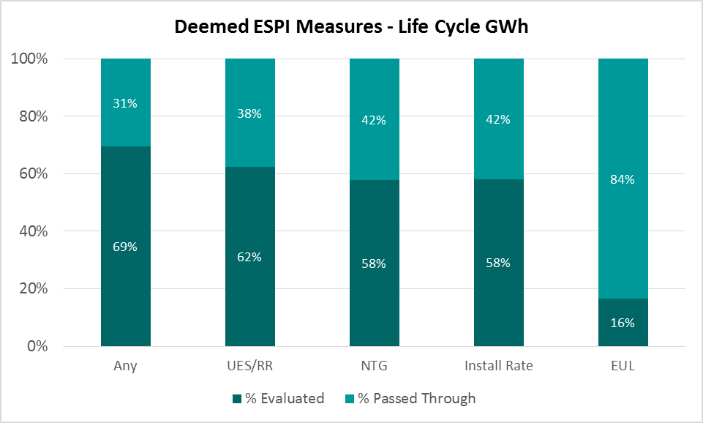
Drivers

Slide 11
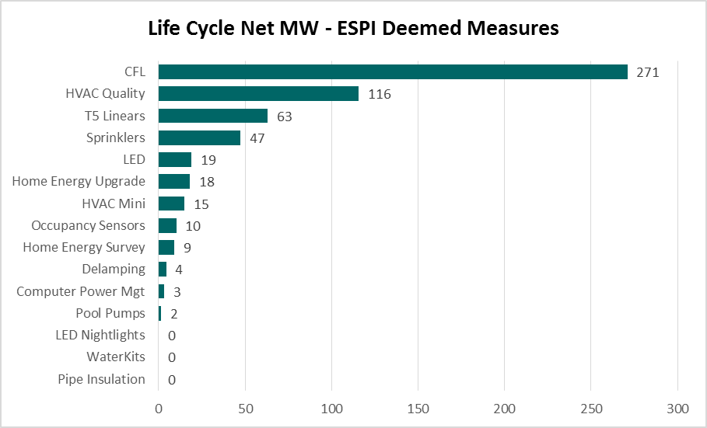
Drivers

Slide 12
Appendices
Appendix A: Performance Statement Workbooks (embedded file)
Appendix B: 2013 ESPI Database (embedded ReadMe file)
Appendix C: Creation of Ex-Post Dataset

Slide 13
Comments Are Due July 13, 2015

Slide 14
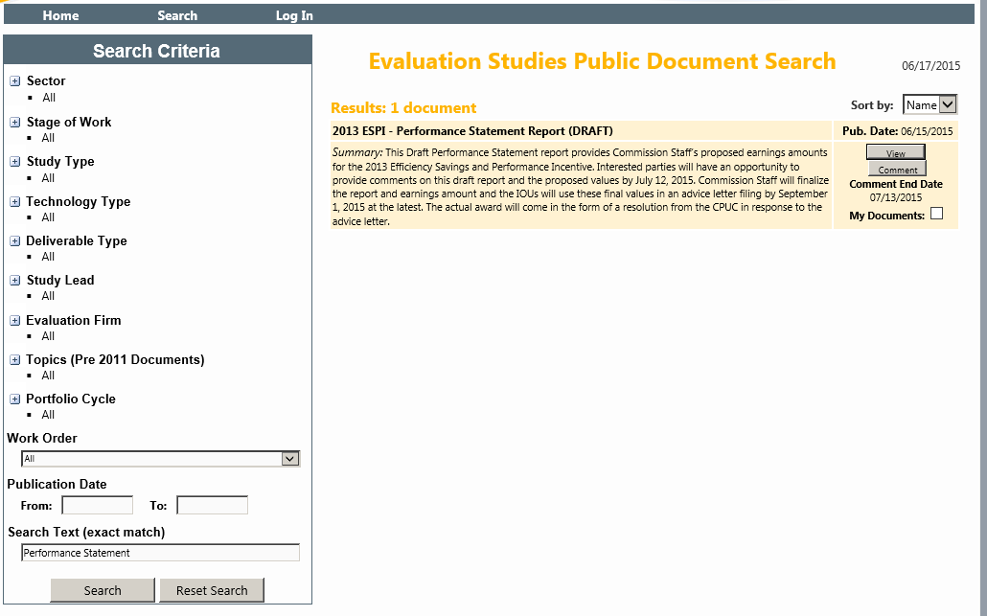
http://www.energydataweb.com/cpuc/search.aspx
Step 1: Enter Performance Statement
Step 2: Click Search

Slide 15
http://www.energydataweb.com/cpuc/search.aspx
Step 3: Click Comment

Slide 16
Overview of Workbooks

Slide 17
Overview of Database

Slide 18
Thank you!
Energy Division Contact:
Jeorge Tagnipes
Jeorge.tagnipes@cpuc.ca.gov
415-703-2451

