Slide 1
Smart Inverter Working Group (SIWG)
January 7, 2021 Meeting
1-2:30 PM PST
Please keep yourself muted when not speaking and do NOT put the call on hold. If muted by the leader, press *6 to unmute.

Slide 2
Agenda
Topic | Time | Presenter
Intro and Agenda | 1:00 – 5 minutes | Sophie Meyer
Continued IEEE 1547 Discussion | 1:05 – 60 minutes | Mike Jensen of PG&E, Roger Salas of SCE
Continued D.20-09-035 Issue 9 Discussion | 2:05 – 20 minutes | Roger Salas of SCE
Wrap Up and Next Steps | 2:25 – 5 minutes | Sophie Meyer

Slide 3
Rule 21 Update with IEEE1547-2018/IEEE1547.1-2020
IEEE 1547-2018
Clause 4 continuation, 7, 8, 9, 10 and 11 Discussion
Smart Inverter Working Group
1/7/2021

Slide 4
Agenda
Welcome
Review of the schedule
Discussion of remaining Clause 4 Issues.
Discussion of Clauses, 7, 8, 9, 10 and 11 (time permitting).
Q&A

Slide 5
Proposed SIWG Schedule for 2020-2021

Slide 6
Clause 4

Slide 7
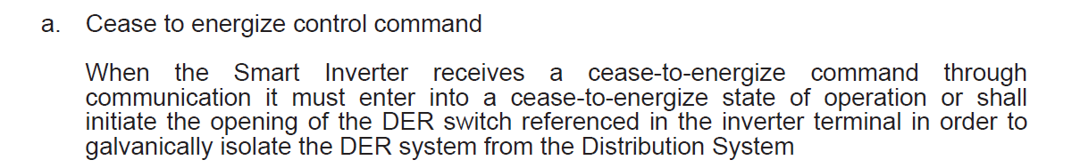
Rule 21 Proposed Modification For IEEE 1547 section 4.6
Control Capabilities
1 changes proposed for this section
Section 4.6.1 – Capability to Disable Permit Service
Rule 21 – Section Hh.8.a
Current Rule 21 language
Add the following language
(Specify the time requirements)
and Trip Within 2 seconds. This shall be accomplished by disabling Permit service as required in IEEE1547-2018 section 4.6
12/17/2020- accepted But change the term Cease-to-energize with “Disable Permit Service”
When the Smart Inverter receives a disable permit service command through communication, the Smart Inverter must cease-to energize and trip within 2 seconds or initiate the opening of the DER switch referenced in the inverter terminal in order to galvanically isolate the DER system from the Distribution System
Comment: Take a look at this language. Ensure language coordinates with the requirements of return-to -service

Slide 8
Rule 21 Proposed Modification For IEEE 1547 section 4.6
Control Capabilities
3 changes proposed for this section
No comments provided
Section 4.6.3 – Execution of mode or parameter changes
Add new section Hh.8.d
IEEE 1547 4.6.3
Transition between modes shall commence in no more than 30 s after the mode setting change is received
at the local DER communication interface. Changes of control functional modes shall be executed such that
the DER output is transitioned smoothly over a time period between 5 s and 300 s.
Ramping of DER output is not required for control parameter setting changes. For all control and protective function parameter settings, the time following the input to the local DER communication interface and preceding the point in time when the invoked action begins shall be no greater than 30 s.
Need to investigate the need for the green in coordination with the ramp control requirements in section 4.10
01/07/2021 Update
IEEE1547 is appropriate for this section given a changes of modes or parameters are not anticipated to be cyclic in normal operations.

Slide 9
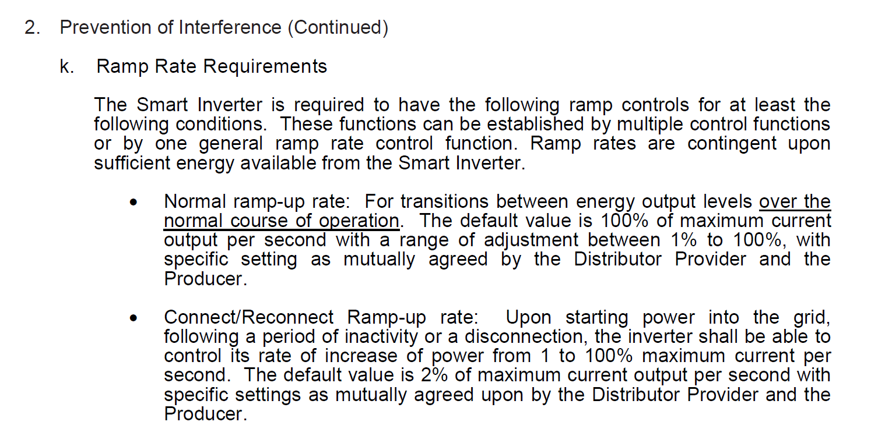
Rule 21 Proposed Modification For IEEE 1547 section 4.10
Enter Service
Section 4.10 Enter Service
Rule 21 section Hh.1.a.ii, Hh8.b, Hh.2.k
Current Rule 21 language
Rule 21 language Changes
k. Enter Service and normal operation Ramp Rate Requirements
The Smart Inverter is required to have the following ramp controls for at least the following conditions. These functions can be established by multiple control functions or by one general ramp rate control function. Ramp rates are contingent upon sufficient energy available from the Smart Inverter.
  Normal ramp-up rate: For transitions between energy output levels over the normal course of operation. The default value is 100% of maximum current output per second with a range of adjustment between 1% to 100%, with specific setting as mutually agreed by the Distributor Provider and the Producer.
  Connect/Reconnect Ramp-up rate: Upon starting power into the grid, following a period of inactivity or a disconnection, the inverter shall be able to control its rate of increase of power from 1 to 100% maximum current per second. The default value is 2% of maximum current output per second with specific settings as mutually agreed upon by the Distributor Provider and the Producer.
  Enter Service requirements as outlined in IEEE1547-2018 section 4.10.3 with following default settings
    Delay Enter Service per Hh.1.a.ii (15 seconds)
    Default Enter Service Duration of 300 seconds
Need to investigate normal ramp-up in relation to:
Applicability only to energy storage inverters
Applicability to Power Limit Command
Applicability to Frequency/Watt
Support grid needs
Need to discuss this the second ramp control in R21 but not in IEEE 1547 with emphasis on Storage charging/discharging which may be frequent and create grid issues
What do with do with this one?
01/07/2021 Update
Smart Inverters used for energy storage applications shall include ramp-up rate control. The default value shall be 100% of maximum current output per second or lower if required by applicant with specific settings, when required, as mutually agreed by the Distribution Provider and the Producer. Prioritization of ramp response should be in accordance to IEEE1547-2018 4.7
Comment: Input on the applicability of ranges of adjustement. IOUs agree to strike the requirement.

Slide 10
Rule 21 Proposed Modification For IEEE 1547 section 4.12
Integration with Area Grounding
Section 4.12 – Integration with Area Grounding
Not previously Discussed
Rule 21 section Hh.2.e
Update references
e. Integration with Distribution Provider’s Distribution System Grounding The grounding scheme of the Smart Inverter shall not cause over-voltages that exceed the rating of the equipment connected to Distribution Provider’s Distribution System and shall not disrupt the coordination of the ground fault protection on Distribution Provider’s Distribution System (IEEE 1547 2018, 4.12 -4.1.2) (See Section G.1.i, line configuration).
Investigate applicability of this section
01/07/2021 Update
IOUs discussed language and no changes are being proposed

Slide 11
Clauses, 7,8,9,10 & 11

Slide 12
Rule 21 Proposed Modification For IEEE 1547 Section 7.0
Power Quality
Section 7.1 “Limit of DC Injection – Ca Rule 21 has the same language,
no changes recommended.
IEEE 1547-2018 language:
Existing Ca Rule 21 H.2.h and Hh.2.h

Slide 13
Rule 21 Proposed Modification For IEEE 1547 Section 7.0
Power Quality
Section 7.2 Limitation of voltage – Not currently in Ca Rule 21, recommend adding to Rule 21 Section H.2 and Hh.2
IEEE 1547-2018 language:

Slide 14
Rule 21 Proposed Modification For IEEE 1547 Section 7.0
Power Quality
IEEE 1547-2018 language:
Modify H.2.d and Hh.2.d to include section IEEE 1547 2018 7.2.3.

Slide 15
Rule 21 Proposed Modification For IEEE 1547 Section 7.0
Power Quality
Section 7.3 Limitation of current distortion – Recommend modifying Ca Rule 21
to match IEEE 1547-2018.
Modify Ca Rule 21 Table H3, Hh.3
to replace even harmonic values
with Table 27.

Slide 16
Rule 21 Proposed Modification For IEEE 1547 Section 7.0
Power Quality
Section 7.4 Limitation of overvoltage over one fundamental frequency period
IEEE 1547-2018 language:
Recommend adding to Rule 21 Section H.2 and Hh.2

Slide 17
Rule 21 Proposed Modification For IEEE 1547 Section 7.0
Power Quality
Section 7.4 Limitation of overvoltage over one fundamental frequency period
IEEE 1547-2018 language:
Recommend adding to Rule 21 Section H.2 and Hh.2. This is a type test performed in IEEE 1547.1 5.17.2 (Load Rejection OV Test)

Slide 18
Rule 21 Proposed Modification For IEEE 1547 Section 8.1
Unintended Islanding
IEEE 1547-2018 Unintentional Island language:
Rule 21 Section Hh.1 Already has similar language recommend no change.

Slide 19
Rule 21 Proposed Modification For IEEE 1547 Section 8.1
Unintended Islanding (UI)
IEEE 1547-2018 UI language:
(IEEE 1547-2018 6.2.1.)
Ca Rule 21 Hh.1.a
Rule 21 Section Hh.1 Already has similar language recommend no change other than changing IEEE 1547 reference.
(IEEE 1547-2018 6.3)

Slide 20
Rule 21 Proposed Modification For IEEE 1547 Section 8.2
Intentional Islanding
Rule 21 is does not address Intentional Islanding. This is addressed in other proceedings (need to list the other proceeding) Recommend not including in this revision of Rule 21.

Slide 21
Rule 21 Proposed Modification For IEEE 1547 Section 9.0
DER on Distribution Secondary Grid/Area/ Street (grid) networks and spot networks.
IEEE 1547-2018 Allows DER on Secondary Networks under the following conditions: Presently Rule 21 is does not specifically address DER on secondary networks.
Keep Rule 21 as-is, do not incorporate in Rule 21 at this time.

Slide 22
Rule 21 Proposed Modification For IEEE 1547 Section 10.0
Interoperability, Information Exchange, Information models, and Protocols
Rule 21 Sections Hh.2.p, Hh.5.a –b,Hh.6., and Hh.7 address communication, monitoring, telemetry and control requirements :
IEEE 1547-2018 language:
Rule 21 language (Section Hh.5) is very similar recommend keeping with minor changes (ie changing date of 2/22/2019 to 1/1/22 to conform to new requirements)

Slide 23
Rule 21 Proposed Modification For IEEE 1547 Section 10.0
Section 10.2 Monitoring Control and Information Exchange Requirements
IEEE 1547-2018 language:
Add to Ca Rule Hh.7.
Add to Ca Rule Hh.7 under “Namplate”.
Add points to Ca Rule Hh.7.a.
Include in Ca Rule Hh.6.a. and Hh.8.a

Slide 24
Rule 21 Proposed Modification For IEEE 1547 Section 10.0
Section 10.3 Nameplate Information
IEEE 1547-2018 language:
Add nameplate section and reference IEEE 1547-2018 reference to Ca Rule 21 Section Hh.7 (Monitoring and Telemetry Requirements).

Slide 25
Rule 21 Proposed Modification For IEEE 1547 Section 10.0
Section 10.4 Configuration Information.
IEEE 1547-2018 language:
Add to Ca Rule 21 Hh.7 under the added “Nameplate Information”.

Slide 26
Rule 21 Proposed Modification For IEEE 1547 Section 10.0
Section 10.5 Monitoring Information.
IEEE 1547-2018 language:
Recommend including these points in Rule 21 Section Hh.7.a

Slide 27
Rule 21 Proposed Modification For IEEE 1547 Section 10.0
Section 10.6 Management Information.
IEEE 1547-2018 language:
Each Mode and Function is summarized below.
Constant Power Factor - Included in Rule 21 as “fixed power factor function Hh.6.a.ii, add reference to IEEE 1547-2018 10.6.2.
Voltage Reactive Power - Included in Rule 21 as “dynamic Volt/Var function”, Hh.6.a.i, add reference to IEEE 1547-2018 10.6.3.
Active Power Reactive Power – Do not add.
Constant Reactive Power – Need to add in Rule 21 in Hh.6.a, with reference to IEEE 1547-2018 10.6.5.
Voltage Active Power- Included in Rule 21 as “volt/watt function”, Hh.6.a.iii, add reference to IEEE 1547-2018 10.6.6.
Voltage Trip and Momentary Cessation -Need to add in Rule 21 in Hh.7.a, add reference to IEEE 1547-2018 10.6.7.
Frequency Trip- Need to add in Rule 21 in Hh.6.a, with reference to IEEE 1547-2018 10.6.8.
Frequency Droop- Need to add in Rule 21 in Hh.6.a, with reference to IEEE 1547-2018 10.6.9.
Enter Service- Included in Rule 21 Hh.8.a.ii as “Return to service control”, add reference to IEEE 1547-2018 10.6.10.
Cease to Energize and Trip-Existing in Rule 21 Hh.8.a.i, add reference to IEEE 1547-2018 10.6.11.
Limit Maximum Active Power- Included in Rule 21 Hh.8.a.iii as “Limit Active Power Command”, add reference to IEEE 1547-2018 10.6.12.

Slide 28
Rule 21 Proposed Modification For IEEE 1547 Section 10.0
Section 10.6 Management Information.
IEEE 1547-2018 language:
This is covered in Rule 21 6.a.ii

Slide 29
Rule 21 Proposed Modification For IEEE 1547 Section 10.0
Section 10.6 Management Information.
IEEE 1547-2018 language:
This is covered in Rule 21 6.a.i

Slide 30
Rule 21 Proposed Modification For IEEE 1547 Section 10.0
Section 10.6 Management Information.
IEEE 1547-2018 language:
This function is not implemented in Rule 21, do not add.
This is covered in Rule 21 6.a.ii

Slide 31
Rule 21 Proposed Modification For IEEE 1547 Section 10.0
Section 10.6 Management Information.
IEEE 1547-2018 language:
This is covered in Rule 21 6.a.iii

Slide 32
Rule 21 Proposed Modification For IEEE 1547 Section 10.0
Section 10.6 Management Information.
IEEE 1547-2018 language:
Presently Rule 21 does not include this data, add to Rule 21 Section 7.a.

Slide 33
Rule 21 Proposed Modification For IEEE 1547 Section 10.0
Section 10.6 Management Information.
IEEE 1547-2018 language:
Presently Rule 21 does not include this data, add to 6.a.

Slide 34
Rule 21 Proposed Modification For IEEE 1547 Section 10.0
Section 10.6 Management Information.
IEEE 1547-2018 language:
Presently Rule 21 does not include this data, add to section 6.a.

Slide 35
Rule 21 Proposed Modification For IEEE 1547 Section 10.0
Section 10.6 Management Information.
IEEE 1547-2018 language:
Existing in Rule 21 Hh.8.a.ii

Slide 36
Rule 21 Proposed Modification For IEEE 1547 Section 10.0
Section 10.6 Management Information.
IEEE 1547-2018 language:
Existing in Rule 21 Hh.8.a.i
Recommend no change:
Existing in Rule 21 Hh.8.a.iii

Slide 37
Rule 21 Proposed Modification For IEEE 1547 Section 10.0
Section 10.7 Communication Protocol Requirements.
IEEE 1547-2018 language:
Ca Rule 21 be left as is, Hh.5.a ii is an additional option.
Hh.5.a

Slide 38
Rule 21 Proposed Modification For IEEE 1547 Section 10.0
Section 10.7 Communication Protocol Requirements.
IEEE 1547-2018 language:
Existing in Rule 21 Hh.5.b.iv
Recommend no change:
Hh.5.b

Slide 39
Rule 21 Proposed Modification For IEEE 1547 Section 10.0
Section 10.8 Communication Performance Requirements.
IEEE 1547-2018 language:
Add to Rule 21 Hh.5.b. Create v. “Communication performance shall meet requirements of IEEE 1547-2018 10.8.”

Slide 40
Rule 21 Proposed Modification For IEEE 1547 Section 10.0
Section 10.9 Cyber Security Requirements.
IEEE 1547-2018 language:
Separate Cyber Group Should Address this requirement.

Slide 41
Rule 21 Proposed Modification For IEEE 1547 Section 11.0
Section 11.0 Testing and Verification Requirements
Rule 21 Section L. Certification and Testing Criteria
Keep the majority of the text with updates standard references (IEEE 1547.1, 1547-2018 and UL 1741 SB.

Slide 42
Rule 21 Proposed Modification For IEEE 1547 Section 11.0
Section 11.4 Fault Current Characterization
Add this section to Rule 21 to Table L.2.
L.3.a

Slide 43
Rule 21 Proposed Modification For IEEE 1547 Section 11.0
Section 11.0 Testing and Verification Requirements
Rule 21 L.3.a
Modify to include new
sections of UL1741-SB
and update IEEE 1547.1. Add column
to Include 1547 2018 smart inverter, to
differentiate SWIG smart inverters.

Slide 44
Discussion

Slide 45
Ordering Paragraph 15
Issue 9 – Continue discussion
Step 2
January 7, 2020
Decision Issued: 9-24-2020
Target Completion of Step 2: End of February, 2021
Tier 3 AL to be filed: 3/24/2021

Slide 46
Meeting Agenda
Welcome
Review Step #2 in detail
Background on ICA development
Background on Issue 9
Review and Discuss Process Block Diagram
Next Steps

Slide 47
Breaking down OP 15 – Step 2
Step #2:
Within six months of issuance of this decision, Utilities shall submit a Tier 3 Advice Letter providing:
  Recommendations (as applicable) regarding the standard review
  Certification requirements
  Interconnection processes necessary for implementation of the proposal.
Decision Issued: 9/30/2020
Tier 3 AL due: 3/28/2021
Therefore, completion of Step 2 should be by 2/24/2021 as we need input from Step #2 for Tier 3 AL.

Slide 48
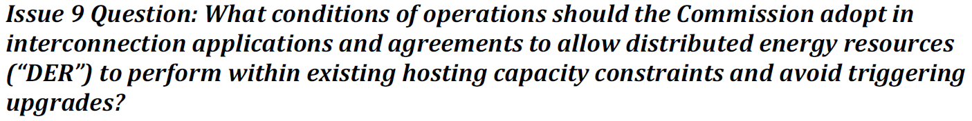
Issue 9

Slide 49
What is Hosting Capacity Values (ICA Values in CA)
ICA Methodology:
  Developed as part of the AB327 DRP
  ICAWG team discussed as part of Track I DRP proceeding
  October 2017, PUC Track 1 ruling provides requirement to develop ICA values for system wide by July 2018 (eventually moved to December 2018)
ICA Use Case: Interconnection Application of DERs
  Calculates ICA values for Thermal, Steady State Voltage, Power Quality, Protection, and safety (OF) independently from each other
  Calculates the available hosting capacity at each of the three phase nodes. For reference, for SCE each circuit has average of approximately 600 three phase electrical nodes
  Calculated for 576 hours of the year (12 months, each month’s high and low days- 24 days *12 = 576 hours)
  Calculates a technology agnostic value and translates the agnostic ICA value to a typical fixed PV ICA value
  Calculates three types of ICA values:
    ICA with no operation flexibility (now known as ICA-Static Grid – ICA-SG)
    ICA with operational flexibility (now known as ICA-Operational Flexibility- ICA-OF)
    Load ICA values (not related to this order)
  Must be published for customer to view and download the information. SCE published at: https://ltmdrpep.sce.com/drpep/

Slide 50
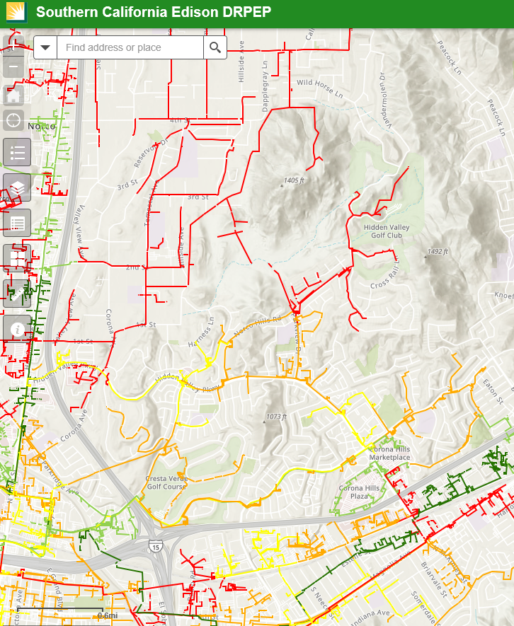
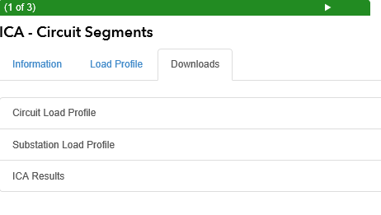
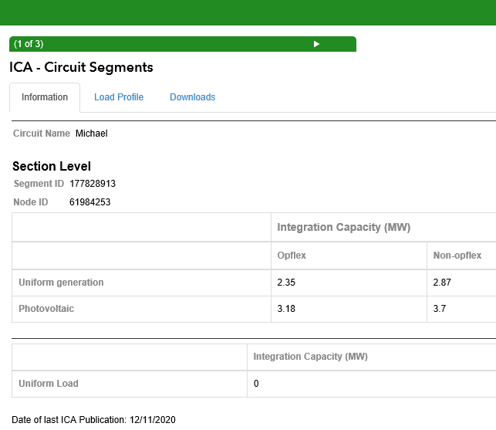
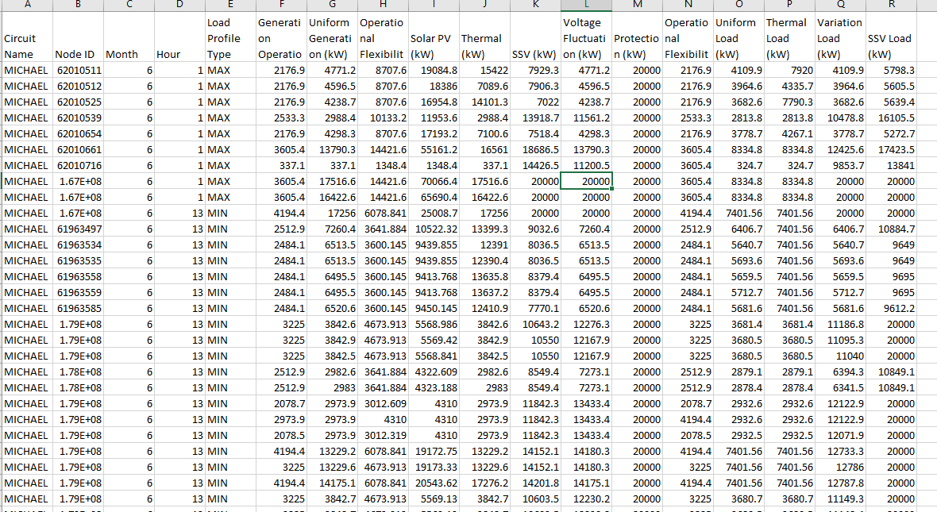
What is Hosting Capacity Values (Example- SCE DRPEP
  https://ltmdrpep.sce.com/drpep/
Download Access
3-phase Electrical Node
Data ready to be analyzed
Lowest ICA-SG Value in the ICA-SG profile
Lowest ICA-OF value in the ICA-OF profile

Slide 51
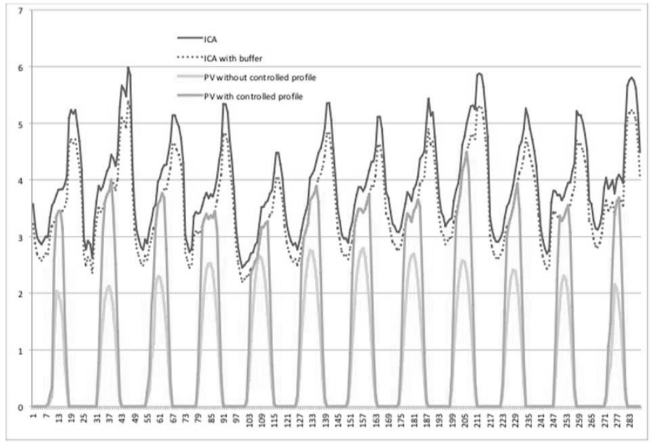
Issue 9 – Non-IOU Proposal
Source: Rule 21 WG 2 Report Pg. 120
Proposal acknowledge that a buffer between ICA-SG and Operating profile was needed but did not specify the buffer
Proposed that the technology was available but did not provide specific details
Proposed the future reduction of generation profiles may be necessary

Slide 52
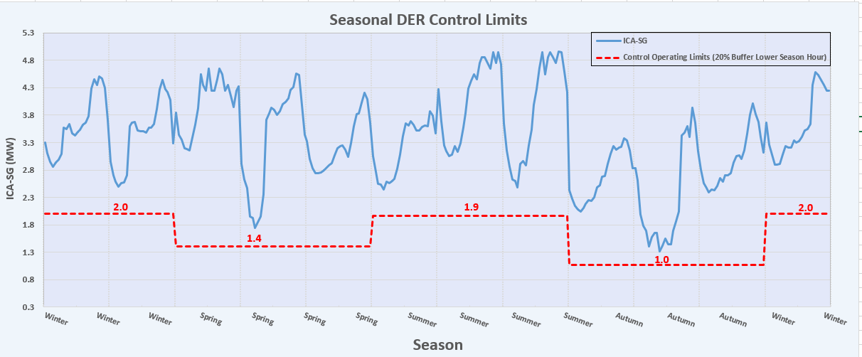
Issue 9- IOU Proposal
Source: Rule 21 WG 2 Report Pg. 125
Adopts several element from the non-IOU proposal but provides detail further details
Proposed to use season periods
Proposed to use of 20% buffer
Proposed the future reduction of generation profiles may be necessary

Slide 53
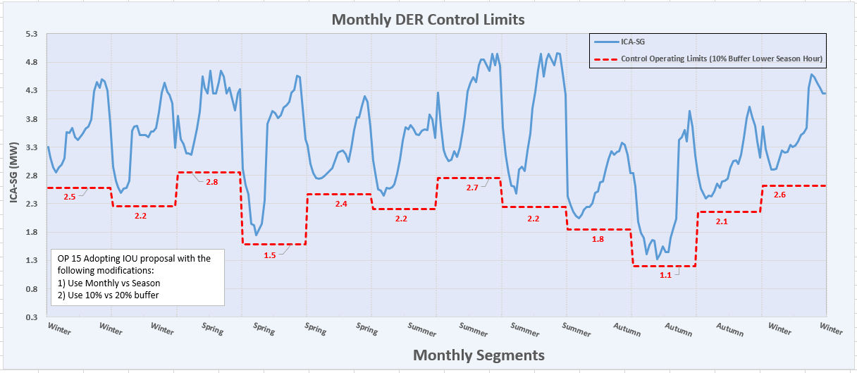
Issue 9- PUC Adopted (OP 15)
Source: Final PUC Order (D.20-09-035) @Pg. 220
Adopts IOU proposal with modifications
Requires use of Monthly
Requires use of 10% buffer
Proposed the future reduction of generation profiles may be necessary
Consult the SIWG for implementation details

Slide 54
Review and Approval Process (For Discussion)

Slide 55
Ordering Paragraph 15
Issue 9
As required by OP 15 – Utilities shall, within 90 days, commence discussion with SIWG on implementing the proposal
December 17, 2020
Decision Issued: 9-24-2020
Meetings must commence prior to: 12/24/2020
Today: 12/17/2020

Slide 56
Meeting Agenda
Welcome
Review OP 15
Breaking down OP 15
Discussion Draft Schedule
Next Steps

Slide 57
Ordering Paragraph 15 (Issue 9)
Adopted IOUs’ counter-proposal to resolve Issue 9, with modification.
Within 90 days of the decision, Utilities shall commence discussions with the SIWG focused on implementing the proposal.
Within six months the decision, Utilities shall submit a Tier 3 Advice Letter providing recommendations (as applicable) regarding the standard review, certification requirements, and interconnection processes necessary for implementation of the proposal.
Within 60 days of adoption of a certification scheme for the Limited Generation Profile, Utilities shall modify Rule 21 Interconnection Application Process to allow a DER customer to include a Limited Generation Profile with their application, require the customer to enable generation profile limiting functionality, and allow Utilities opportunity to alter the profile if safety and reliability concerns warrant it.
  Retroactive alterations to the ICA values within the interconnection process and addressing whether the Commission should continue use of the 10% buffer or adjust it, based on the data generation profiles shall not reduce generation to below a pre-defined static level, i.e., the lowest ICA – Static Grid typical profile value identified at the time of the Interconnection Application.
  As part of the proposal, Utilities shall:
  allow customers to utilize a smart inverter’s ability to increase its output on a monthly basis; and
  use a 10% buffer, which shall be revisited.
  No later than 18 months after the implementation of this proposal, Utilities shall submit a Tier 3 Advice Letter providing data obtained from Proposals 8b and 8c, adopted below, assessing the effectiveness of the use of the ICA values within the interconnection process and addressing whether the Commission should continue use of the 10 percent buffer or adjust it, based on the data.

Slide 58
Breaking down OP 15 – Step 1
Step #1:
Within 90 days of the issuance of this decision, Utilities shall commence discussions with the Smart Inverter Working Group focused on implementing the proposal.
Decision Issued: 9/24/2020
90 days from Decision: 12/24/2020
Today: 12/17/2020
Today’s meeting is to meet this requirement: Commence Discussion on implementation of the proposal

Slide 59
Breaking down OP 15 – Step 2
Step #2:
Within six months of issuance of this decision, Utilities shall submit a Tier 3 Advice Letter providing:
  Recommendations (as applicable) regarding the standard review
  Certification requirements
  Interconnection processes necessary for implementation of the proposal.
Decision Issued: 9/24/2020
Tier 3 AL due: 3/24/2021
Therefore, completion of Step 2 should be by 2/24/2021 as we need input from Step #2 for Tier 3 AL.

Slide 60
Breaking down OP 15 – Step 3
Step #3:
Within 60 days of adoption of a certification scheme for the Limited Generation Profile, Utilities shall modify the Rule 21 Interconnection Application Process to:
Allow a distributed energy resources customer to include a Limited Generation Profile with their application,
Require the customer to enable generation profile limiting functionality, and
Allow Utilities opportunity to alter the profile if safety and reliability concerns warrant it.
Anticipated adoption (approval) certification Scheme for Limited Generation Profile: 12/31/2020*
Relying on the approval of the revised UL PCS standard currently being updated via weekly working UL PCS working group meetings
If John Berdner or Tim Zgonena are in the call, they may provide an update
Rule 21 shall be modified by: 3/01/2021.
  Assuming that adoption of a certification scheme would be by 2/1/2020
  Assuming this would be done through an Advice Letter although the order does not specify that.
  Assuming approval of certification Scheme for Limited Generation Profile by 12/31/2020
There is some conflict between Step #2 and Step #3. Some clarification and support from the commission may be good here:
  Do we need an AL for this? If so, can this be done in the same AL as that of Step #2?

Slide 61
Breaking down OP 15 – Step 3
Step #3 Continued:
Retroactive alterations to the generation profiles shall not reduce generation to below a pre-defined static level, i.e., the lowest Integrated Capacity Analysis – Static Grid typical profile value identified at the time of the Interconnection Application.
As part of the proposal, Utilities shall:
i) allow customers to utilize a smart inverter’s ability to increase its output on a monthly basis; and
ii) use a 10% buffer, which shall be revisited.

Slide 62
Breaking down OP 15- Step 4
Step #4: Not part of SIWG discussion (Reporting)
No later than 18 months after the implementation of this proposal, Utilities shall submit a Tier 3 Advice Letter providing data obtained from Proposals 8b and 8c, assessing the effectiveness of the use of the ICA values within the interconnection process and addressing whether the Commission should continue use of the 10% buffer or adjust it, based on the data.

Slide 64
Next Steps
Next meeting will be focused on the elements of Step #2

Slide 65
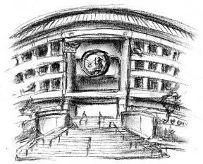
Thank you!
For Additional Information visit:
http://www.cpuc.ca.gov/General.aspx?id=4154
or contact Sophie Meyer at:
sme@cpuc.ca.gov

