Slide 1
Load Impact Evaluation:
SCE Demand Response Aggregator Contracts
Dan Hansen
May 2023

Slide 2
Presentation Outline
Resource Description
Ex-post Methodology
Ex-post Load Impacts
Ex-ante Methodology
Ex-ante Load Impacts
Comparison of Prior Ex-ante and Current Ex-post Load Impacts

Slide 3
1. Resource Description
Three Demand Response Aggregators (DRAs) had active contracts during 2022:
  Hybrid Electric Building Technologies (Hybrid)
  Stem Energy (Stem)
  Swell Energy (Swell)
Hybrid and Stem enrolled commercial and industrial customers to provide demand response within SCE’s service territory; Swell enrolled residential and small commercial customers
  DRAs nominate customers on a monthly basis
  SCE dispatched the contracts according to the associated terms
  DRA is responsible for meeting the contract obligations

Slide 4
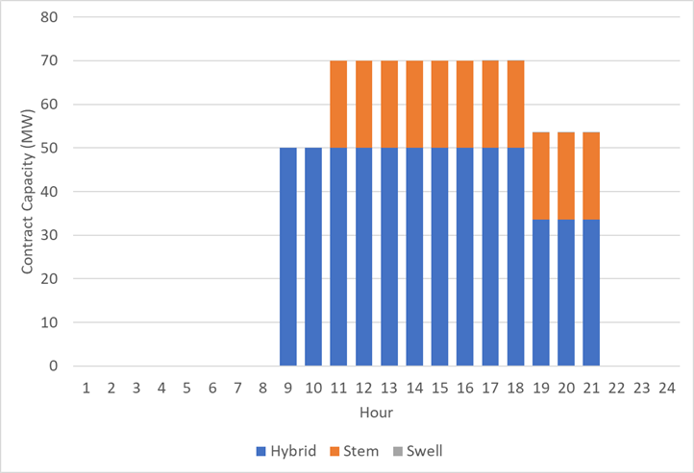
1. Resource Description:
Maximum Capacity for 2022 DRA Contracts
Month | Total Contract Capacity (MW)
 | Hybrid | Stem | Swell | Total
8 to 10 a.m. | 50 | 0 | 0 | 50
10 a.m. to 4 p.m. | 50 | 20 | 0 | 70
4 to 6 p.m. | 50 | 20 | 0.1 | 70.1
6 to 9 p.m. | 33.5 | 20 | 0.1 | 53.6

Slide 5
2. Ex-post Methodology
Estimated customer-specific regression models with the customer’s hourly usage as the dependent variable
Models are used to simulate reference loads that would have occurred in the absence events
The explanatory variables include:
  Temperatures, expressed in several ways (e.g., current hour, average daily, maximum daily)
  Hour of day
  Day of week
  Month of year
  A morning load variable (average load from midnight to 10 a.m., except for customers with early event hours)

Slide 6
2. Ex-post Methodology (2)
October 2021 through September 2022 data included in the model
  Exclude event hours plus at least 3 hours following the event
    If the event starts at 5 p.m. or later, the rest of the day is excluded
    Needed to include some event-day data to improve estimates for contracts with a high frequency of events
  Exclude data prior to the customer’s first nominated month, which ensures that storage is in place (if applicable)
Model validation
  Estimated a common specification excluding ~15% of the data (randomly selected non-event days)
  Compared predicted and observed values on withheld days and adjusted the customer’s regression specification as needed
Estimated load impact = the model’s predicted load for the event hour minus the observed load

Slide 7
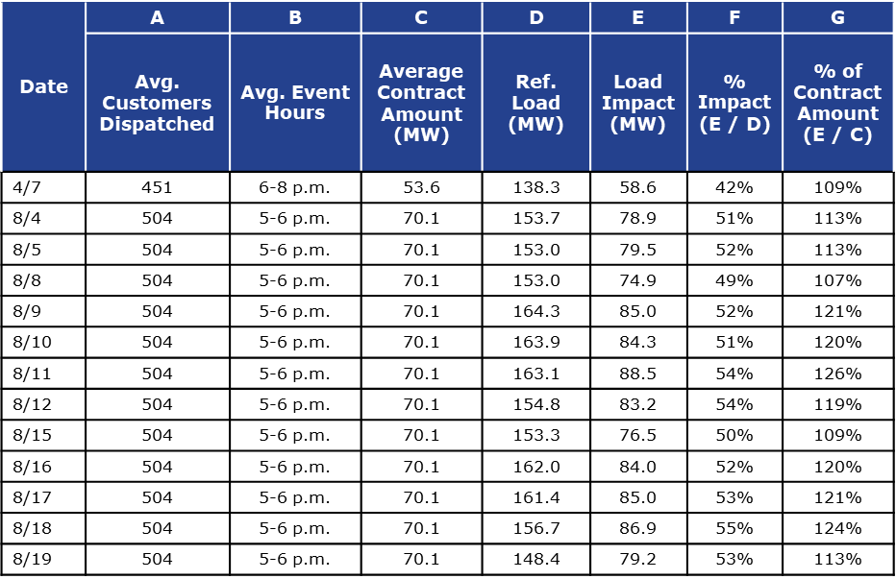
3. Ex-post Results
Average Event Hour with Full Dispatch
Load Impact = our estimate of the difference between observed loads and the loads that would have occurred in the absence of the event
% Impact = Load Impact / Reference Load
% of Contract Amount = Load Impact / Contract Amount
Includes only event hours with all resources dispatched within a contract
Notes:
Can be complicated to summarize ex-post impacts because events don’t necessarily overlap across or within contracts. The table only includes data when the contract was fully dispatched, meaning one would expect it to meet its full contract obligation in that hour.

Slide 8
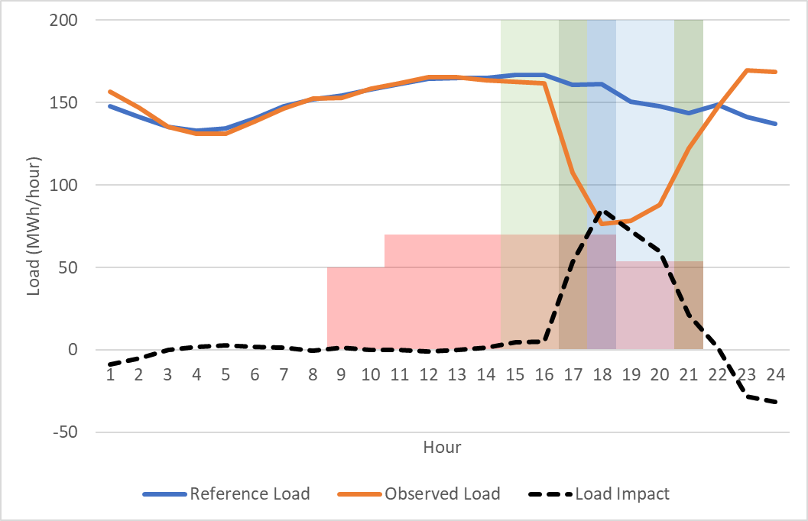
3. Ex-post Results
August 17, 2022 Hourly Load Impacts
Dark blue shading = Full dispatch
Light blue = All but 1 dispatch ID called
Dark green = All Hybrid or all Stem called
Light green = One Hybrid ID called
Red shading = Contract quantities

Slide 9
4. Ex-ante Methodology
SCE provided a forecast of monthly capacity commitments by contract
  Replaces the enrollment forecast typically used in a load impact study
Simulate customer-specific reference loads for all required scenarios (by month and weather scenario)
  Same as ex-post regression model but omitting the morning load variable

Slide 10
4. Ex-ante Methodology:
Contracts in the Ex-Post Study
Ex-ante load impacts are a straightforward translation of the ex-post estimates
  No weather effect on load impacts, so no statistical modeling is needed
  Forecast is drawn from corresponding observed hours, e.g., HE 17 ex-post impacts are used to forecast HE 17 ex-ante impacts
  Hourly forecast impacts are built up from dispatch ID-level estimates (allows us to use all events and not just full-dispatch events)
Contracts have a maximum 4-hour event duration, whereas the Resource Adequacy window is 5 hours long
  Simulate all 5 hours to reflect the resource’s potential in each hour of the RA window
Forecast contract quantities matched ex-post contract quantities, so no adjustment was needed for that

Slide 11
4. Ex-ante Methodology:
Contracts NOT in the Ex-Post Study
For contracts not in the ex-post study, we have no customer load data or historical performance upon which to base the ex-ante forecast
We follow the assumption from the previous evaluation, applying an assumed percentage to the contract value to forecast the load impacts that will be provided

Slide 12
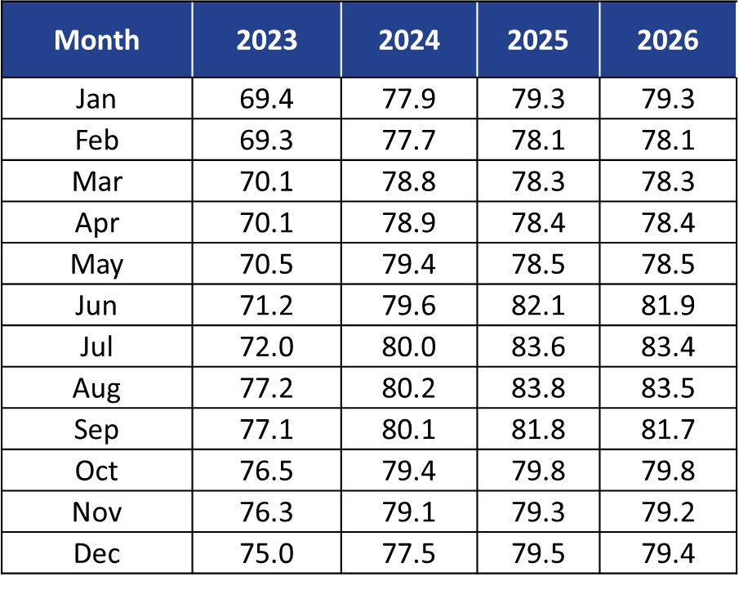
5. Ex-ante Load Impacts:
Forecast Contract Quantities (MW)

Slide 13
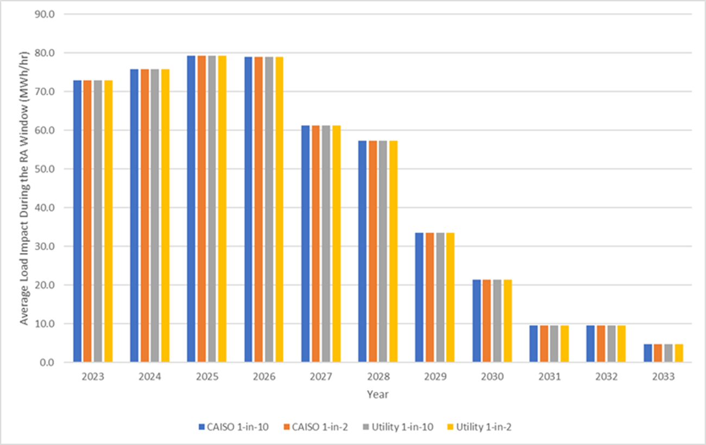
5. Ex-ante Load Impacts:
Average August RA Window Impacts (MW)
Contract Achievement in August 2023 = 94.5%

Slide 14
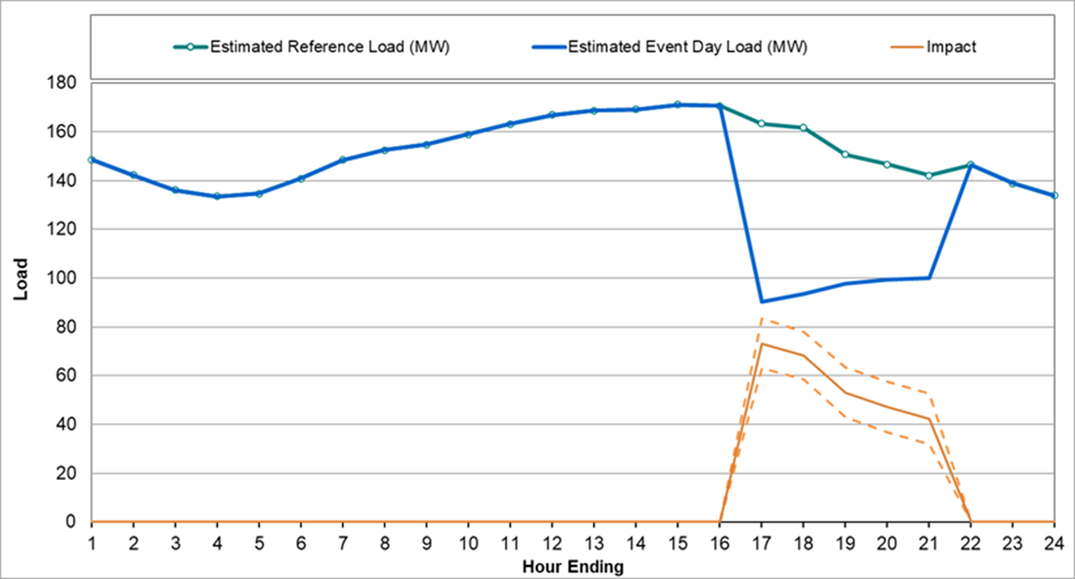
5. Ex-ante Load Impacts:
August 2023 SCE 1-in-2 Impacts (MW)

Slide 15
6. Comparison of Ex-Ante and Ex-Post Load Impacts
In the table below, we compare the forecast of PY2022 load impacts produced during the PY2021 evaluation (“Previous Ex-Ante”) to the ex-post load impacts estimated as part of this study (“Current Ex-Post”)
The forecasting error at the program level was 0.2 MW, though with slightly higher contract achievement in ex-post vs. the ex-ante forecast
  One contract was somewhat over-forecast while another was under-forecast due to ramping-up issues
  Neither issue caused us to modify our methodology

Slide 16
Questions?
Contact
Dan Hansen
Christensen Associates Energy Consulting
Madison, Wisconsin
  dghansen@CAEnergy.com
  (608)231-2266

