Slide 1
California Public utilities Commission
Consumer Protection and Enforcement Division (CPED)
Access For All Program
Access Fund Administrator (AFA) Guidelines Working Group/Information Session
Cody Naylor, Supervisor
Anna Jew, Analyst
Reagan Rockzsfforde, Analyst
CPED Transportation Analysis Section
July 7, 2020

Slide 2
Housekeeping
Phone lines will not be open and will be on mute for the duration of the presentation.
Staff will Monitor the Chat box. Please let us know if you cannot hear us or see the slides any time during the presentation.
We will answer all questions at the end of the presentation.
This Power Point Presentation along with the required templates will be posted on the CPUC website: https://www.cpuc.ca.gov/tncaccessadmin/
If you have any additional questions after the training, please contract TNCAccess@cpuc.ca.gov.
Notes:
aml

Slide 3
Agenda
Introductions/Open Remarks
Program Overview
Status of Track 3 Proceeding
Access Fund Balance
Overview of Process
Schedule/Key Dates
Phase 1
Phase 2
Phase 3
Phase 4
Q&A
Notes:
aml

Slide 4
Overview of Access Program
Authority and Purpose - Senate Bill 1376 (Hill, 2018) directed CPUC to establish a program relating to accessibility for person with disabilities, including wheelchair users who need a wheelchair-accessible vehicle (WAV).
Access Fee and Access Fund - The $0.10 “Access Fee” is collected on each TNC ride and then remitted for deposit in the CPUC’s “Access Fund” for distribution to “access providers.”
Access Providers - “an organization or entity that directly provides, or contracts with a separate organization or entity to provide, on-demand transportation to meet the needs of persons with disabilities.” [Pub. Util. Code Section 5431.5(a)]
Access Fund Administrators - “shall distribute funds in the Access Fund on a competitive basis to access providers that establish on-demand transportation programs or partnerships to meet the needs of persons with disabilities, including wheelchair users who need a WAV.” [Pub. Util. Code Section 5440.5(1)(C)]
Allocation of Funds - Funds will be allocated annually in each geographic area proportional to the percent of fees originating in that geographic area.
Notes:
aml

Slide 5
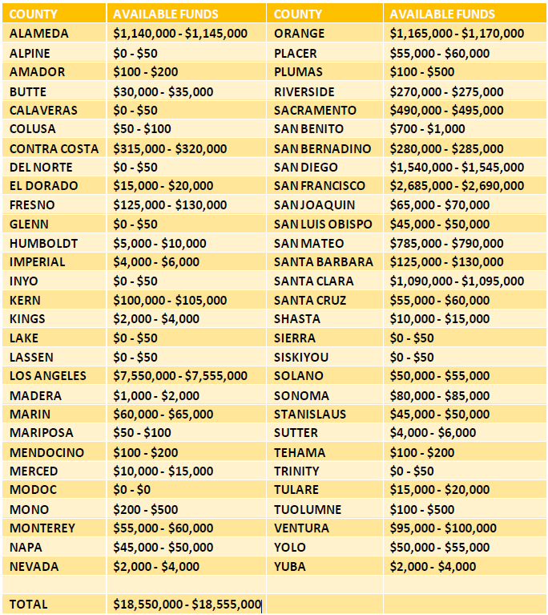
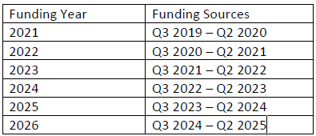
Access Fund
Balance Estimates
Notes:
rr1

Slide 6
Timeline: Proceeding R.19-02-012
September 22
- Governor signed SB 1376
April 21
May 18
- Extended time for Track 3 schedule
March 4
May 7
June 27
March 12
- Scoping Memo and Ruling was issued that establishes three tracks
- Commission opened a Rulemaking (R.)19-02-012 to implement SB 1376
- Commission adopted Decision (D.)19-06-033 addressing Track 1 issues
- Set $0.10 per trip fee and geographic area
- Commission adopted D.20-03-007 on Track 2 issues
- Established TNC offset requirements; Authorized MPOs / RTPAs / CTCs as AFAs
- Assigned Administrative Law Judge issued Scoping Memo for Track 3
- Full list of issues
2019
2019
2020
2018
2019
2020
2020
Notes:
aml

Slide 7
Timeline: Proceeding R.19-02-012 (Track 3)
June 30
- Parties and CPED submitted proposals on Track 3 issues
July 24
August 8
Q4
Q4
- Reply comments on the workshop and proposals are due
- Workshop on Track 3 proposals
- Proposed decision on Track 3
Final decision on Track 3
July 28
- Comments on the workshop and proposals are due
2020
2020
2020
2020
2020
For more information, visit www.cpuc.ca.gov/tncaccess/
Notes:
aml

Slide 8
Status of Proceeding R.19-02-012
TRACK 3 QUESTIONS RELATING TO AFAs AND ACCESS PROVIDERS
Access Fund Disbursements
  Should a minimum or maximum amount of funding be disbursed to an access provider in response to an application?
  Should the Commission prescribe what purposes moneys disbursed to access providers can be used for, such as maintenance and fuel costs, vehicle purchase and retrofitting costs, driver training, and time involved in providing wheelchair accessible trips?
  Should the Commission directly grant funding to transportation carriers that it does not regulate (e.g., taxicab companies or entities that exclusively provide non-emergency medical transportation)?
  Should access providers that receive Access Fund funding be required to be available for chartering through TNC apps?
  How should applications from access providers be granted or denied (e.g., via Commission resolution or by staff action)?
  How should “on demand transportation” be defined for purposes of selecting on-demand transportation programs or partnerships? What other limitations, if any, should the Commission impose on what entity qualifies as an “access provider”?
  In light of TNCs’ allowance to reduce their own remittances to the Access Fund, should TNCs also be allowed to apply as “access providers” to request additional moneys? Under what circumstances should TNCs be allowed to do so? What conditions should they have to satisfy?
  Should the Commission establish separate qualifying standards for TNCs according to distinguishing criteria such as the number of trips provided in geographic area (e.g., a million or more rides per quarter) or other criteria?
  What additional application requirements should the Commission adopt for access providers, if any? Note that any proposed access provider selection criteria may also be considered as additional criteria for TNC Offset Requests and Exemption Requests.
Notes:
rr1

Slide 9
Status of Proceeding R.19-02-012 (cont.)
TRACK 3 QUESTIONS RELATING TO AFAS AND ACCESS PROVIDERS Cont.
Access Fund Disbursements cont.
  What is an appropriate method or formula for compensating Access Fund Administrators (AFAs)?
  For administration of the Access Fund by the statewide AFA, what qualifying expenses should be established for access providers, if any, that are not otherwise served by a local AFA? How should differences in geographic areas be considered and incorporated into the statewide program available in the absence of a local AFA?
Reporting Requirements
  Pursuant to Pub. Util. Code § 5440.5(a)(1)(J), how should yearly benchmarks be established for TNCs and access providers to meet to ensure WAV users receive continuously improved, reliable, and available service? How should the benchmarks be used? In what form should TNCs and access providers submit such reports to the Commission, and should the reports be publicly available?
  N/A
  What additional reporting requirements, if any, should the Commission adopt for access providers and TNCs?
To access Track 3 Scoping Memo and Ruling, visit: https://docs.cpuc.ca.gov/PublishedDocs/Efile/G000/M333/K877/333877350.PDF
Notes:
rr1

Slide 10
Overview Process and Key Dates
Phase 1
Selection
Acceptance
Phase 2
Programmatic plans
Phase 4
Data reporting
Phase 3
Commission approval
45 days after the end of each quarter
July 30, 2020
Nov. 30, 2020
Disbursement

Slide 11
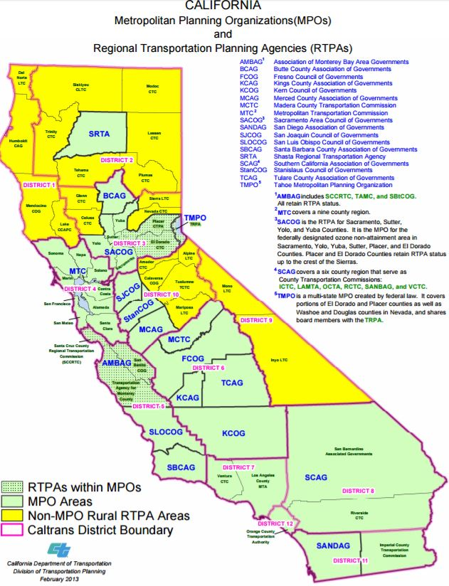
Phase 1 – Selection of AFAs
Eligibility
Decision 20-03-007 limited eligible AFAs to MPOs, RTPAs and CTCs.
There are 38 eligible entities in California covering all the State’s 58 counties.
AFA selection is a non-competitive process.

Slide 12
Phase 1 – Selection of AFAs (cont.)
Acceptance of AFA Responsibilities
AFA’s responsibilities:
Establish a submission process for the access provider application
Select access providers to receive Access Fund moneys based on criteria adopted by the Commission
Distribute Access Fund moneys to selected access providers
Submit a consolidated Quarterly Report to the Commission based on the Quarterly Reports submitted by access providers
Submit on a quarterly basis the amount of Access Fund moneys requested by and distributed to access providers in a quarter and a brief description of the progress made by selected access providers and any compliance or other challenges encountered
Submit an annual certification that Access Fund moneys will be expended and distributed in accordance with the requirements established by the CPUC

Slide 13
Phase 1 – Selection of AFAs (cont.)
Intent to Serve
After reviewing the AFA responsibilities and guidelines, interested entities shall notify Commission staff by July 1, 2020 if they wish to continue to the next phase of the process.
Upon acceptance, AFAs move to Phase 2 and develop programmatic plan

Slide 14
Phase 2 – Program Administration Plan Review
Programmatic Plan
Should be a clear and complete plan to administer the program to eligible access providers
Required Components
Selection of access providers
Disbursement of funds to access providers
Administrative cost
Data reporting and compliance

Slide 15
Phase 2 – Program Administration Plan Review (cont.)
1. Programmatic Plan - Selecting Access Providers
The AFA’s application process must include the following criteria set by the Commission:
how the applicant’s program or partnership would improve response times for WAV service compared to the previous year
the presence and availability of WAVs within the geographic area
efforts undertaken to publicize and promote available WAV services to disability communities
What should be included?
Step-by-step application procedure
Evaluation procedure
  Scoring criteria
Step 1
Criteria
Step 2
Application
Step 3
Scoring / Selection
Step 4
  Approval

Slide 16
Phase 2 – Program Administration Plan Review (cont.)
2. Programmatic Plan - Fund Disbursement Process
Should describe how AFA will disburse moneys to ensure funds are used in accordance with conditions and restrictions of the program
What should be included?
  Step-by-step disbursement process based on established accounting practices
  Systematic tracking to ensure funds are used in accordance to the conditions adopted under the program
Step 1
Step 2
Step 3
Step 4
Notes:
rr1

Slide 17
Phase 2 – Program Administration Plan Review (cont.)
3. Programmatic Plan – Administrative Cost
Should provide annual projected costs of administering the program (only 15% of the allocated funds may be used cover on costs to administer the program
What should be included?
  Administrative costs
    Staffing (e.g. administrative support)
    Contracted services (e.g. accounting, data collection)
    Marketing/outreach
    Office supplies
    Other related costs (identify)
Notes:
rr1

Slide 18
Phase 2 – Program Administration Plan Review (cont.)
4. Programmatic Plan – Data Reporting and Compliance
  Should identify how required data will be collected from access providers based on the requirements adopted by the Commission
    Step-by-step collection procedure
      Number of WAVs in operation
      Number and percentage of WAV trips completed, not accepted, cancelled by passenger, cancelled due to passenger no-show, and cancelled by driver
      Completed WAV trip request response times in deciles
      Evidence of outreach
      Certification of WAV driver training within the past three years
      Report of WAV driver training programs used and number of WAV drivers that completed the training
      Certify that all WAVs have been inspected and approved to conform with the ADA accessibility specifications within the past year.
      Number of complaints
    Follow-up with Access Providers

Slide 19
Phase 3 – Approval & Disbursement
Commission Approval
  Commission staff will prepare a resolution to the Commission seeking approval of the selected AFAs and corresponding annual funding amounts
  Once resolution is approved, Commission staff will notify AFAs of Commission approval by email and the next steps.
Notes:
Aml

Slide 20
Phase 3 – Approval & Disbursement (cont.)
Disbursement of Funds
  A Funding Agreement, which sets forth the terms and conditions of the funding, shall be executed between the CPUC and AFA before the approved funds can be disbursed.
  Commission staff will then initiate the disbursement process within the CPUC’s Fiscal Office. Note that the State Controller’s Office, not the CPUC, will disburse payment to the AFAs in the form of a check.
Notes:
Aml

Slide 21
Phase 4 – Data Reporting Requirements
Consolidated Quarterly Reports from Access Providers
  The consolidated data reports are due 45 days after the end of each quarter (May 15, August 15, November 15, February 15) and include the following:
    Number of WAVs in operation
    Number and percentage of WAV trips completed, not accepted, cancelled by passenger, cancelled due to passenger no-show, and cancelled by driver
    Completed WAV trip request response times in deciles
    Evidence of outreach
    Certification of WAV driver training within the past three years
    Report of WAV driver training programs used and number of WAV drivers that completed the training
    Certify that all WAVs have been inspected and approved to conform with the ADA accessibility specifications within the past year.
    Number of complaints
To access the TNC data template visit: https://www.cpuc.ca.gov/tncaccessAL/
Notes:
aml

Slide 22
Phase 4 – Data Reporting Requirements (cont.)
Amount of Access Funds
  The amount of Access Funds requested by and distributed to access providers shall be reported on a quarterly basis.
  Due 45 days after the end of each quarter (May 15, August 15, November 15, February 15).
Notes:
aml

Slide 23
Phase 4 – Data Reporting Requirements (cont.)
Progress of Access Providers
  A brief description of the progress made by selected access providers shall be reported on a quarterly basis:
    Status of projects
    Compliance or reporting issues
    Other challenges encountered
  Due 45 days after the end of each quarter (May 15, August 15, November 15, February 15).
Notes:
aml

Slide 24
Next Steps
  For MPOs/RTPAs/CTCs that have already indicated interest to become AFA:
      Staff will confirm with you next week via email
      Move to Phase 2 – Develop the programmatic plans
      Submit the plans by July 30
  For those who are still in the process of deciding:
      Notify Staff by July 10 whether your agency wants to become an AFA
      Staff will confirm with you via email next week
      Move to Phase 2 – Develop the programmatic plans
      Submit the plans by July 30
Notes:
aml

Slide 25
Summary of Required Information/Documents
Phase 1: Deadline July 10
  Notify via email to Commission staff if interested to become AFA
Phase 2: Deadline July 30
  Application Form
    Applicant Info
    Programmatic Plan
  Annual Certification/Affidavit Form
  STD 204 Form
Phase 3: Deadline November 30
  Funding Agreement
Phase 4: Deadline February 15, May 15, August 15, November 15
  Quarterly Reports from Access Providers (see TNC’s data template for example)
  Amount of Access Funds requested by and distributed
  Progress of selected Access Providers
To download the application form and other documents related to AFA visit: https://www.cpuc.ca.gov/tncaccessadmin/
Notes:
aml

Slide 26
Links to Program Resources
Senate Bill 1376
To establish a program relating to accessibility for persons with disabilities, including wheelchair users who need a WAV.
D.20-03-007
Track 2 Decision establishes rules and requirements of Senate Bill 1376.
AFA Guidelines and Application form
Step-by-step guide in addition to forms to use when applying
Proceeding Information
To be added to the service list, or to become a party to the proceeding (R.19.02-012).
Notes:
aml

Slide 27
Thank you!
Questions or Comments
Notes:
aml

Slide 28

Thank you!
For Additional Information:
www.cpuc.ca.gov
https://www.cpuc.ca.gov/tncaccessadmin/
TNCAccess@cpuc.ca.gov
Notes:
Cody for closing remarks?

